Slide 1


Leo District Council 325 J
A Genuine Question
Start Slide

Slide 2

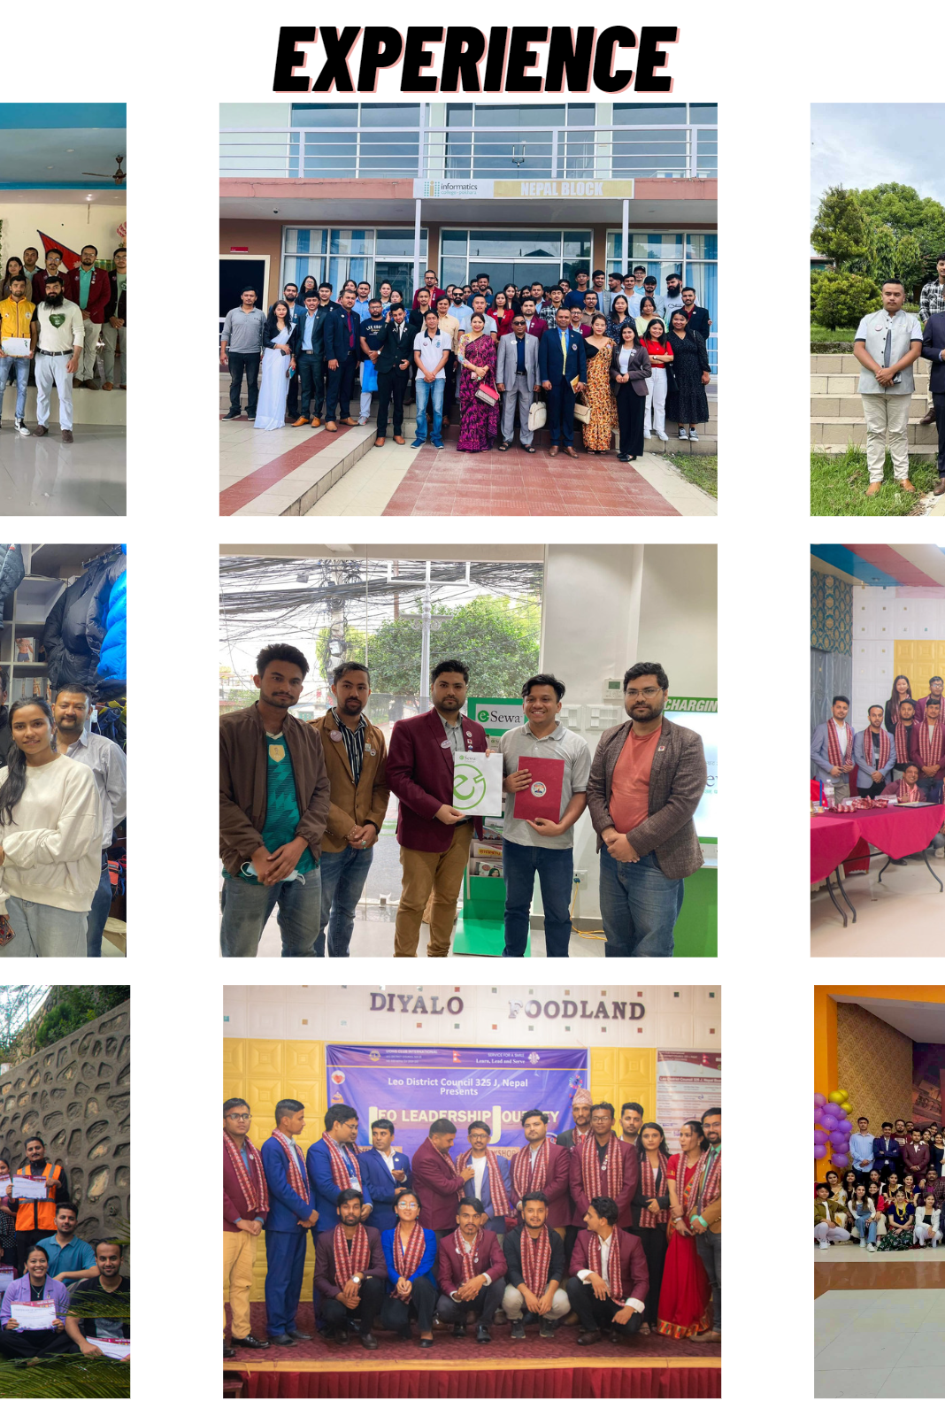


Leo District Council 325 J
EVENTO
Leo’s Event Management System
Bishal Phuyal
www.leodistrictcouncil325jnepal.org.np
Page 02 / 10

Slide 3
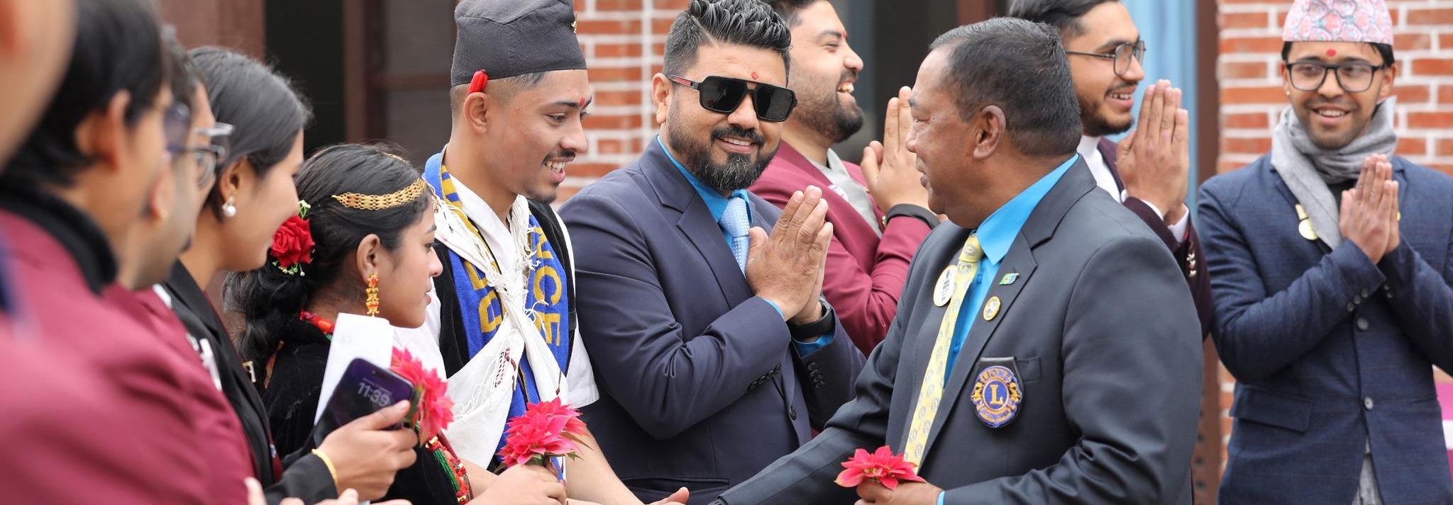
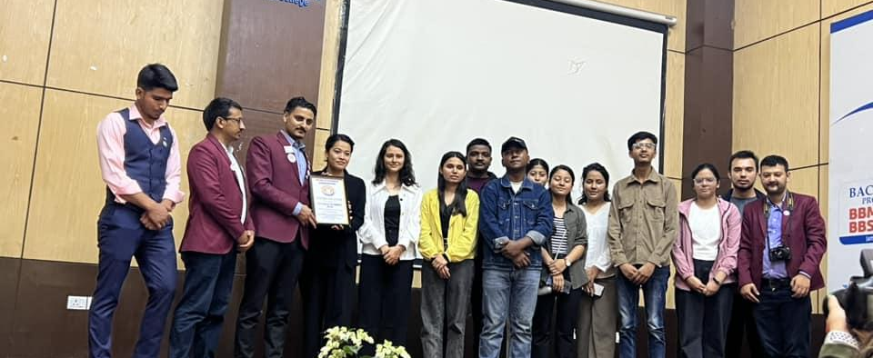
Leo District Council 325 J
01.
International Non-Profitable Non-Governmental Org
02.
MANAGES ALL LEO CLUBS IN 325 J DISTRICT
03.
MISSION:
To empower Lions clubs, volunteers, and partners to improve health and well- being, strengthen communities.
BACKGROUND
www.leodistrictcouncil325jnepal.org.np
Page 03/ 10

Slide 4
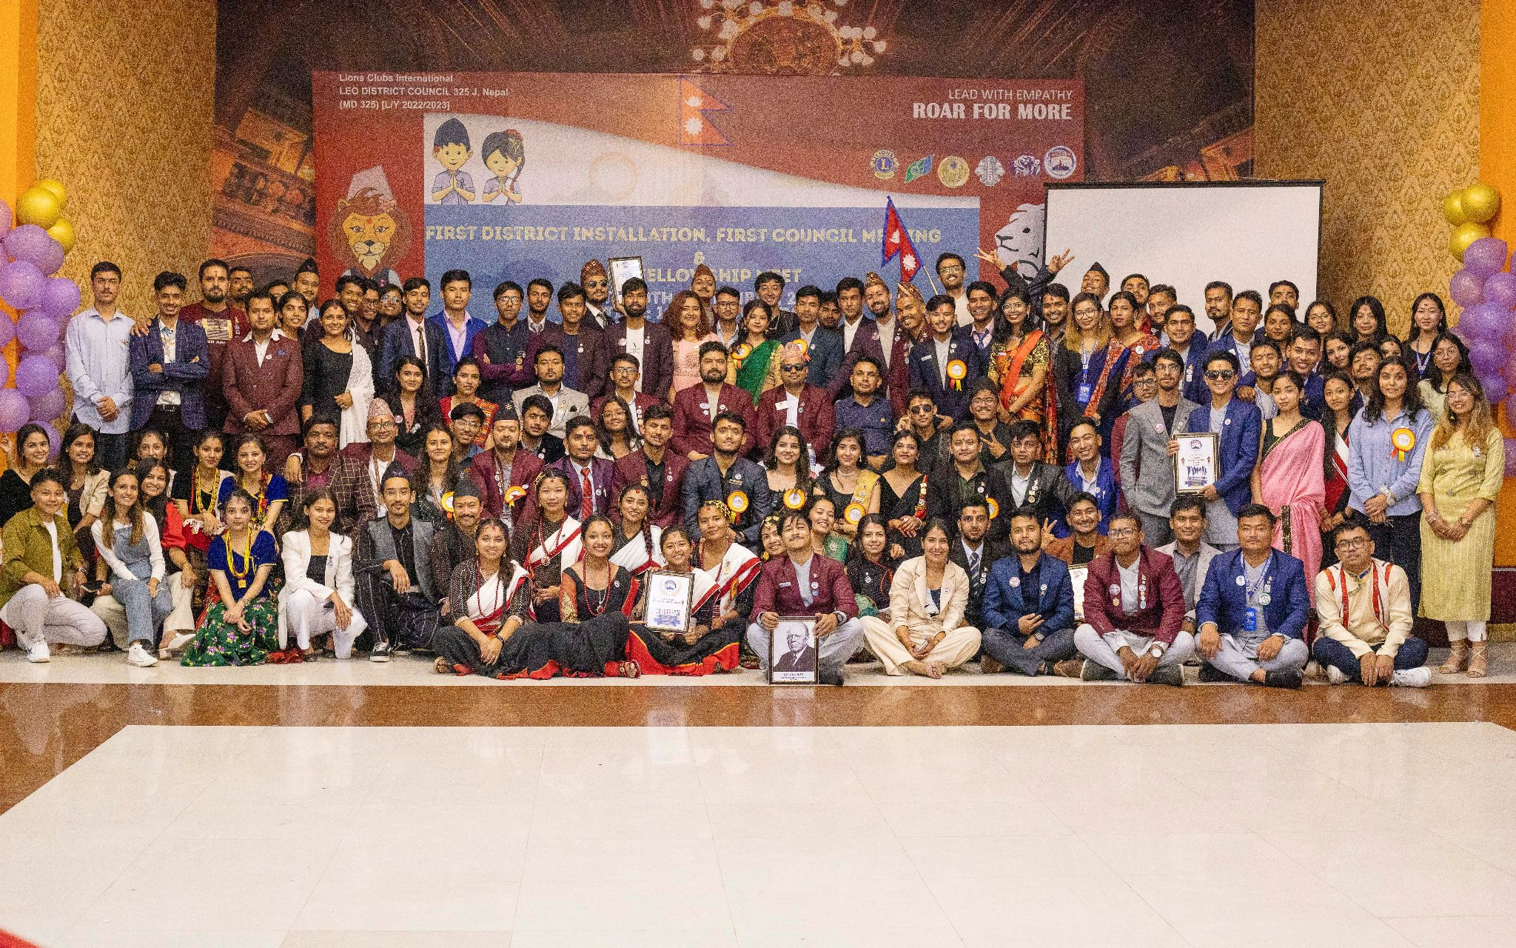
Leo District Council 325 J
INTRODUCTION OF THE SYSTEM
Mobile Application that
Connects Event Searching Individuals and Leo Clubs that handles Events
www.leodistrictcouncil325jnepal.org.np
Page 04 / 10

Slide 5
Leo District Council 325 J
01.
Help Club to Manage and forecast Events Data
02.
Help Individuals to find about Events
OBJECTIVES
www.leodistrictcouncil325jnepal.org.np
Page 05/ 10

Slide 6
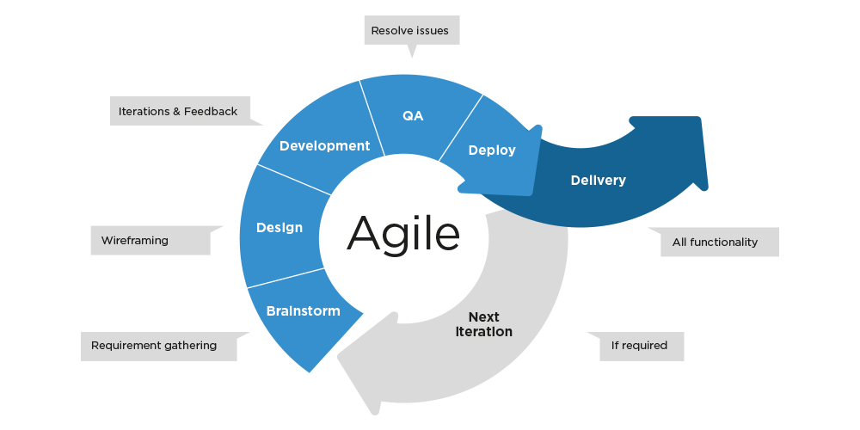
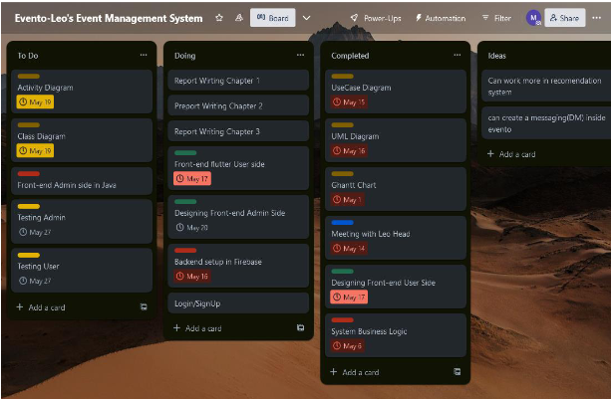
Leo District Council 325 J
METHODOLOGY
KANBAN
www.leodistrictcouncil325jnepal.org.np
Page 06 / 10

Slide 7
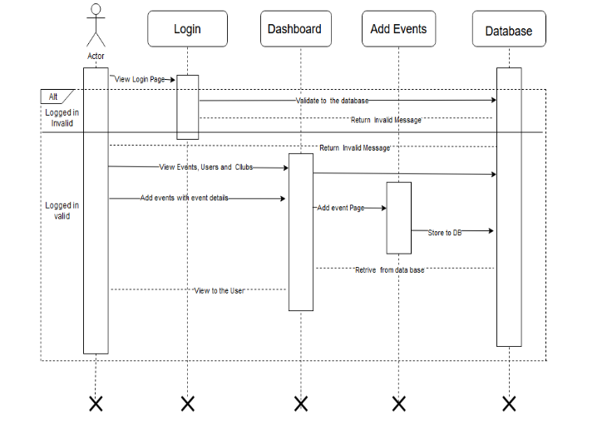
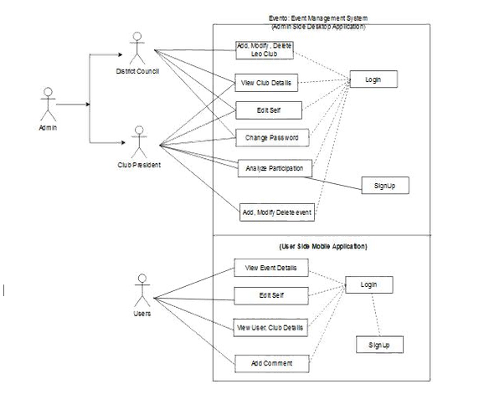
Leo District Council 325 J
DESIGNS
USECASE
SEQUENCE DIAGRAM
Page 07 / 10
www.leodistrictcouncil325jnepal.org.np

Slide 8
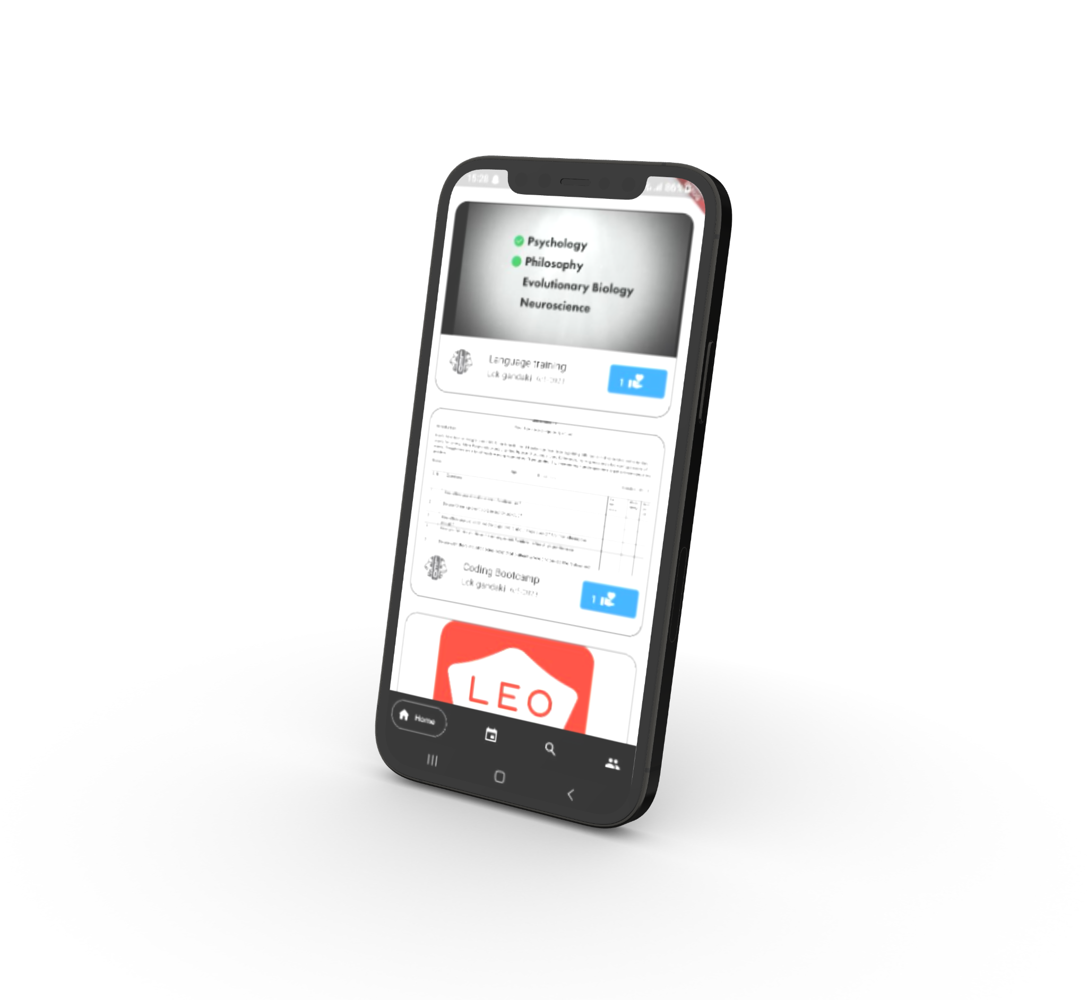
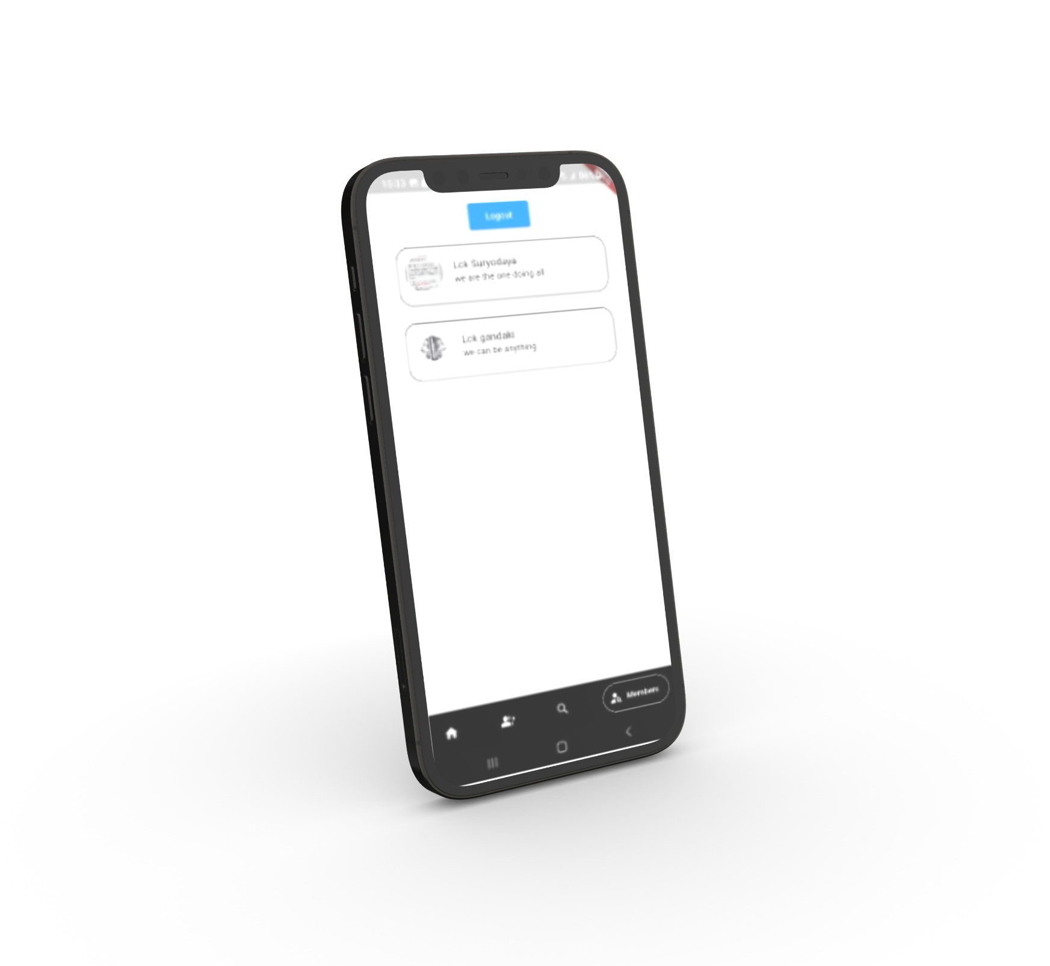
Leo District Council 325 J
IMPLEMENTATIONS
FLUTTER - DART
FIREBASE GIT AND GITHUB
ANDROID SDK
www.leodistrictcouncil325jnepal.org.np
Page 08 / 10

Slide 9

Leo District Council 325 J
MODULES:
01 - Admin can Create Club
02 - Admin can manage users
03 - Club can create Events
04 - Indivisual can Sign Up
05 - Individual can vote Events
06 - Optimized Search Option
www.leodistrictcouncil325jnepal.org.np
Page 09 / 10

Slide 10
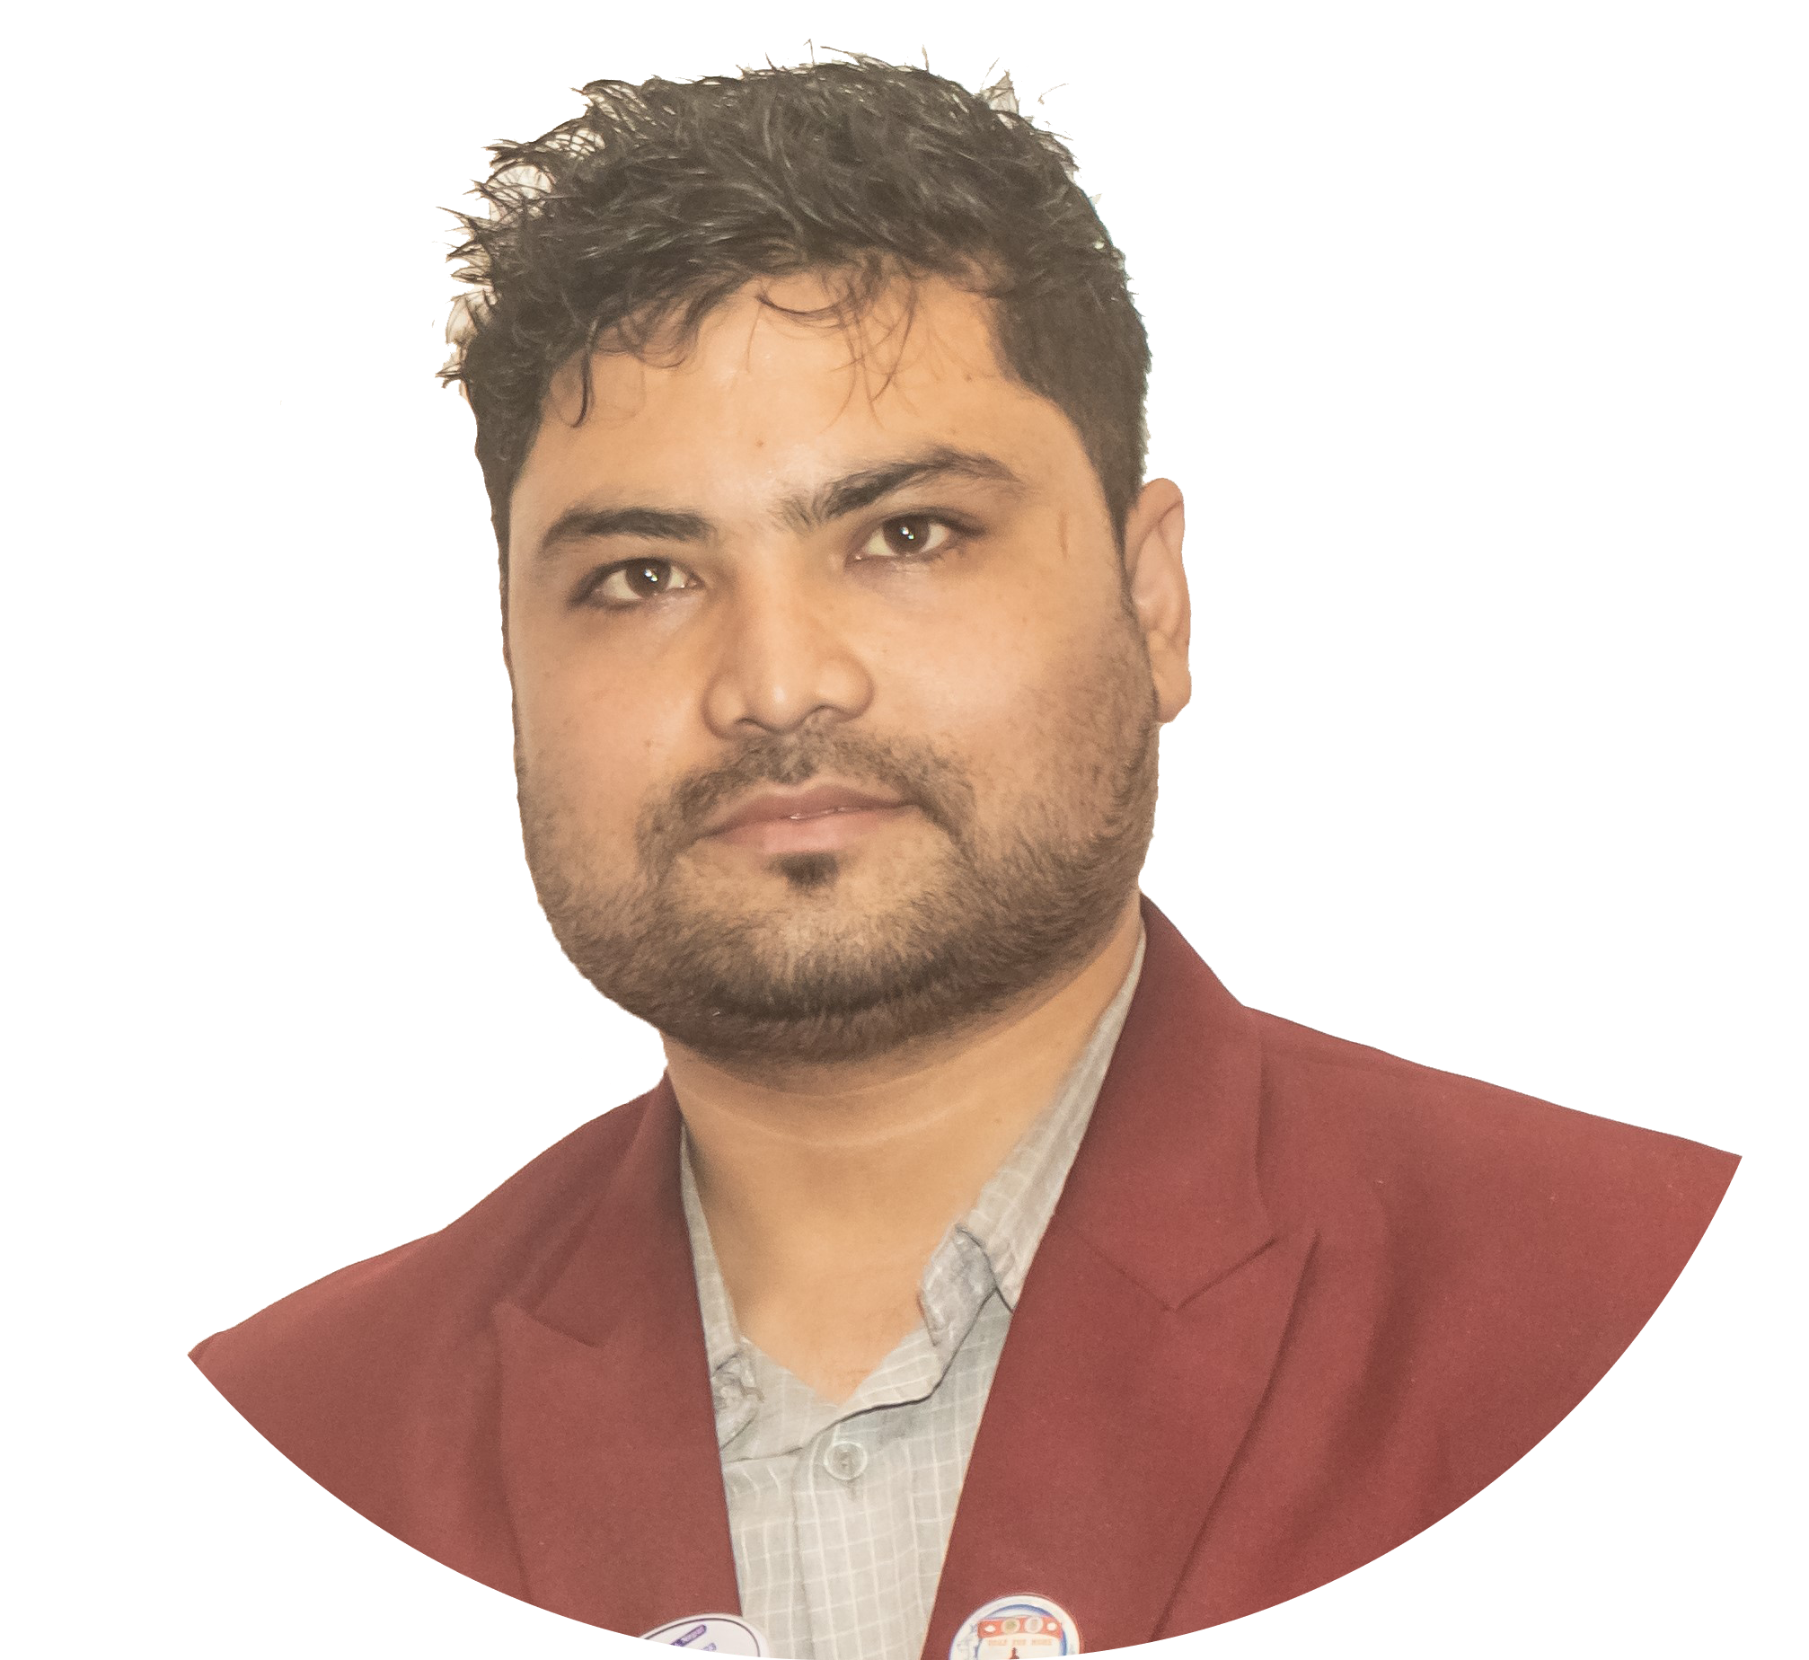
Leo District Council 325 J
CONCLUSION
SYSTEM BUILT IS IN PROCESS OF IMPLEMENTATION AND HAVE POSITIVE FEEDBACK FROM THE PRESIDENTS
Leo KIRAN THAPA,
DISTRICT PRESIDENT
www.leodistrictcouncil325jnepal.org.np
Page 10 / 10

